Slide 1

Agenda
Online summer bridge course

Slide 2
The Java Ladder
Oops Concept
Mini – Project
Day 1

Slide 3
Java Ladder
Classes – Interface
Static – Variables, Methods and block
Packages – Visibility Specifier
The APIE
String Class
Exception Handling
Multi Threading
File Handling
Serialization
Collection framework
JDBC
Wrapper

Slide 4
Java Basics - Runbook
Features of Java
Architecture of JVM
Java as a Concepts
Object Oriented Programming Principles
Java Identifiers

Slide 5
Cont.
Java Keywords
Java Data types
Java Operators
Java Modifiers
Java Variables
Garbage Collection

Slide 6
Features of Java
Object Oriented
Platform independent
Simple
Secure
Architectural-neutral
Portable
Robust

Slide 7
Cont.
Multithreaded
Interpreted
High Performance
Distributed
Dynamic

Slide 8
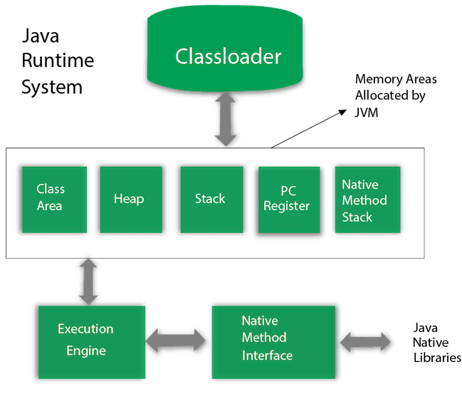
Architecture of JVM

Slide 9
Cont.

Slide 10
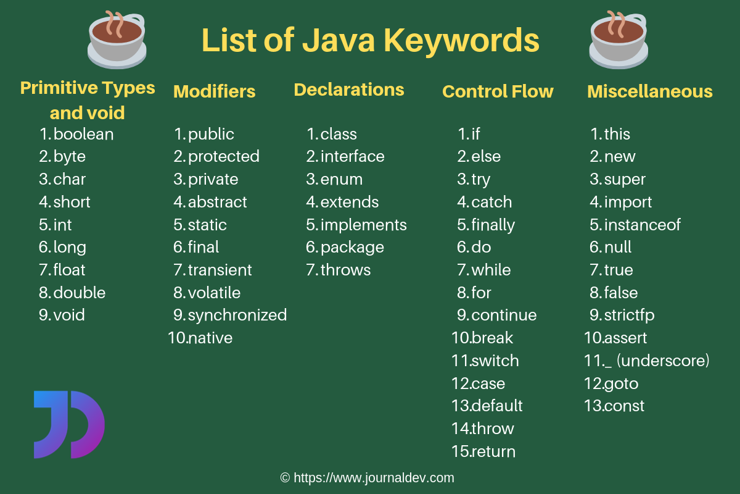
Java Keywords

Slide 11
Java Data types
Primitive Data Types
Non-Primitive Data Types

Slide 12
Primitive Data Type
Byte
Short
Int
Float
Double
Boolean
char

Slide 13
Non - Primitive Data Types
Derived data types
User defined data types

Slide 14
Java Operators
Arithmetic Operators
Relational Operators
Bitwise Operators
Logical Operators
Assignment Operators
Misc Operators

Slide 15
Java Modifiers
Access Modifiers
Non-access Modifiers

Slide 16
Java Variables
Local Variables
Instance Variables (Non-static variables)
Class Variables (Static Variables)

Slide 17
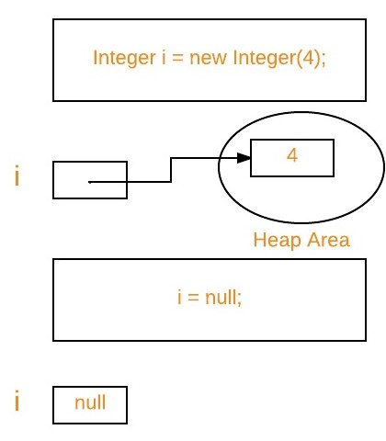
Garbage Collection

Slide 18
Hello World

